Slide 1

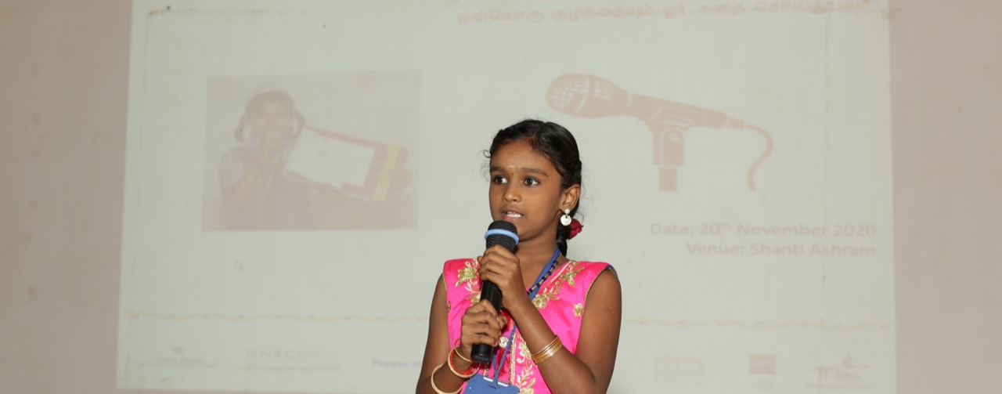
Every child deserves a voice, a platform, and a champion!
Ways to Ensure Effective and Ethical Participation of Children

Slide 2
What is child participation?

Slide 3
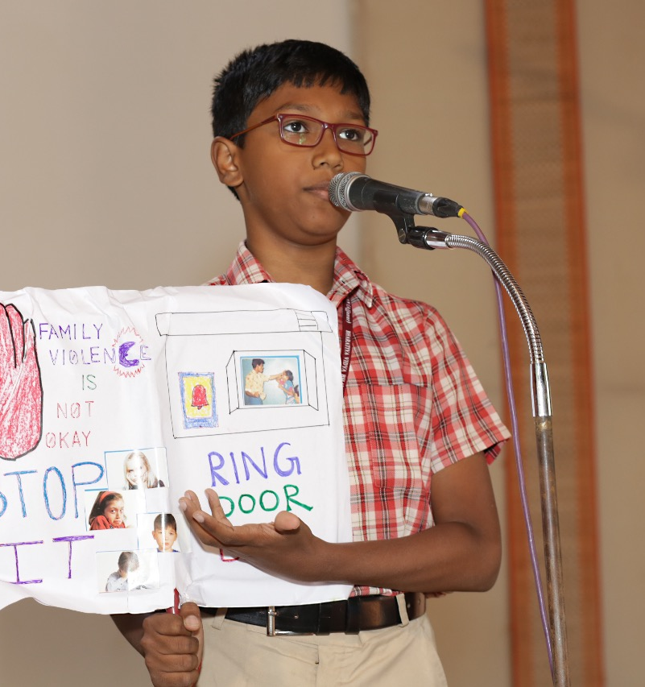

Article 12, UNCRC: State parties shall assure to the child who is capable of forming his or her own views the right to express those views freely in all matters affecting the child, the views of the child being given due weight in accordance with the age and maturity of the child.

Slide 4
Human rights-based approach
Goal
Principle
Means

Slide 5
Why does participation matter?

Slide 6
Child development
Increased protection
Better decision-making and outcomes
Increased accountability

Slide 7
Defining meaningful participation

Slide 8
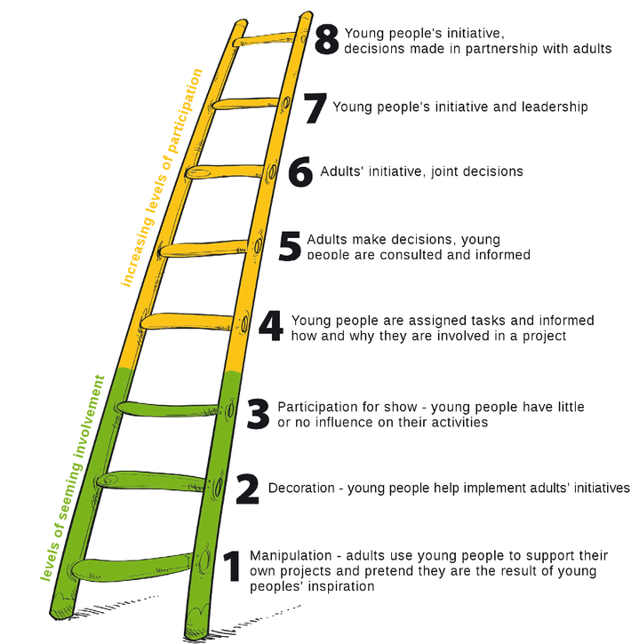
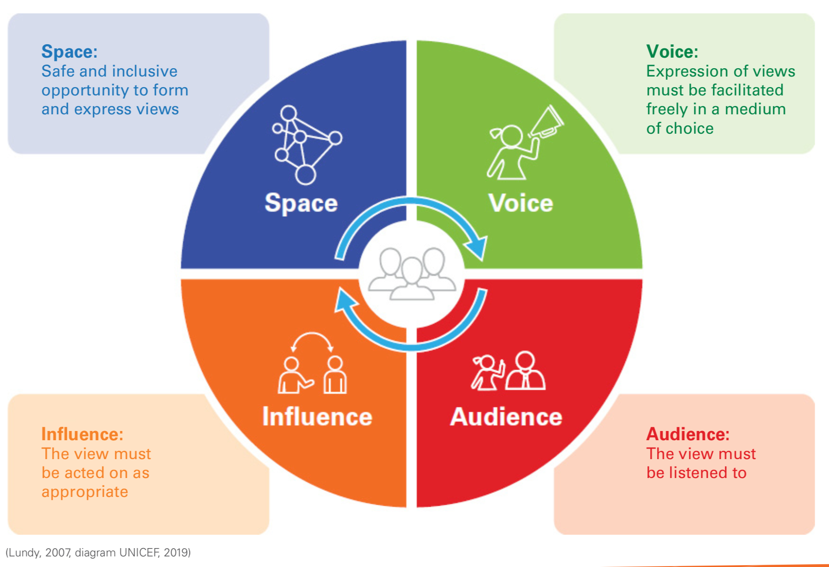
Roger Hart (1992)
Laura Lundy (2007)
(Hart, 1992)

Slide 9
Types of participation

Slide 10
Consultative
Collaborative
Child-led
Adult initiated
Adult-led and managed
No possibility for children to control outcomes
Adult initiated
Partnership with children
Children influence or challenge both process and outcomes
Issues and concerns identified by children themselves
Adults as facilitators rather than leaders
Children control the process

Slide 11
9 Basic Requirements for Effective and Ethical Participation of Children

Slide 12

1. Transparent and Informative
2. Voluntary
3. Respectful
4. Relevant
5. Child-friendly
6. Inclusive
7. Supported by training
8. Safe and sensitive to risk
9. Accountable

Slide 13
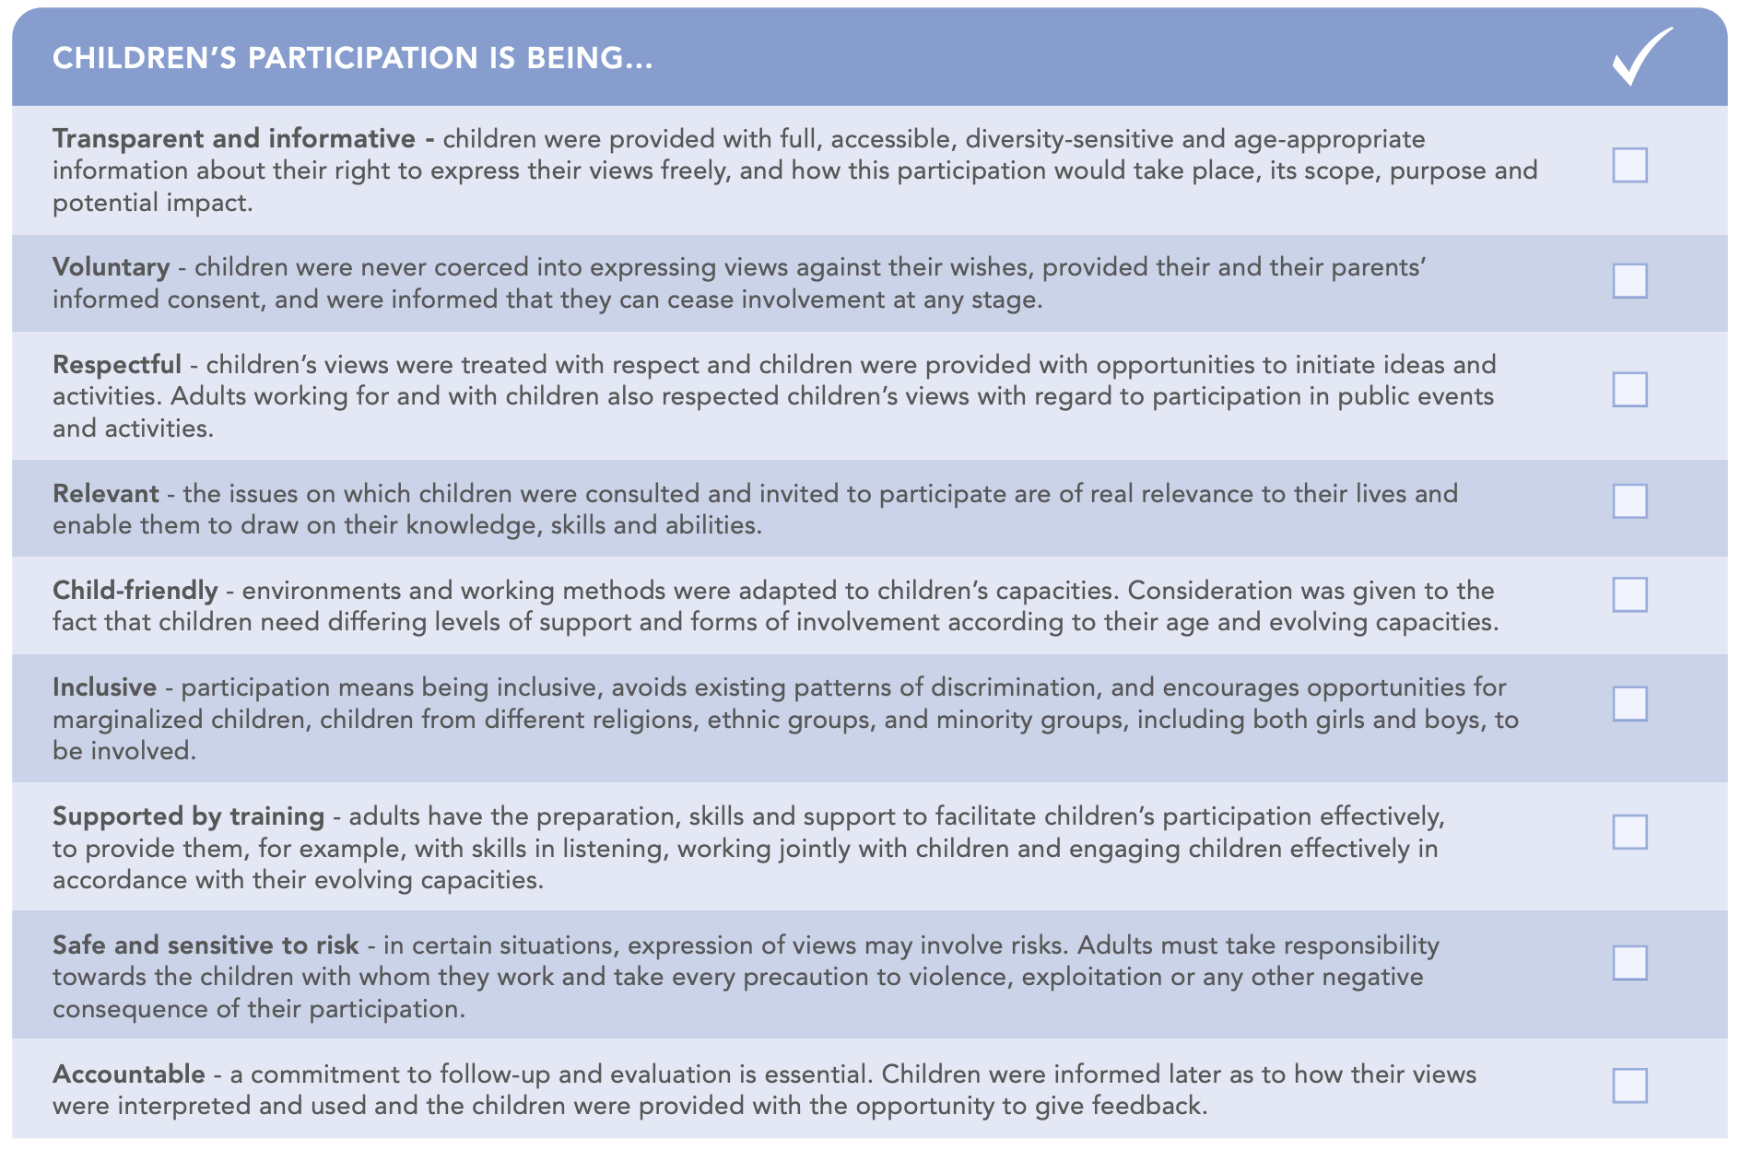

Slide 14
Children’s participation in organizational practice

Slide 15
Internal
Governance
Research
External
Advocacy
Programming
Situation analysis
Planning
Implementation
MEAL
Advocacy
Communication
Fundraising
Awareness raising
Policy-making
Budget
Programming
Implementation

Slide 16
Children’s participation in advocacy

Slide 17
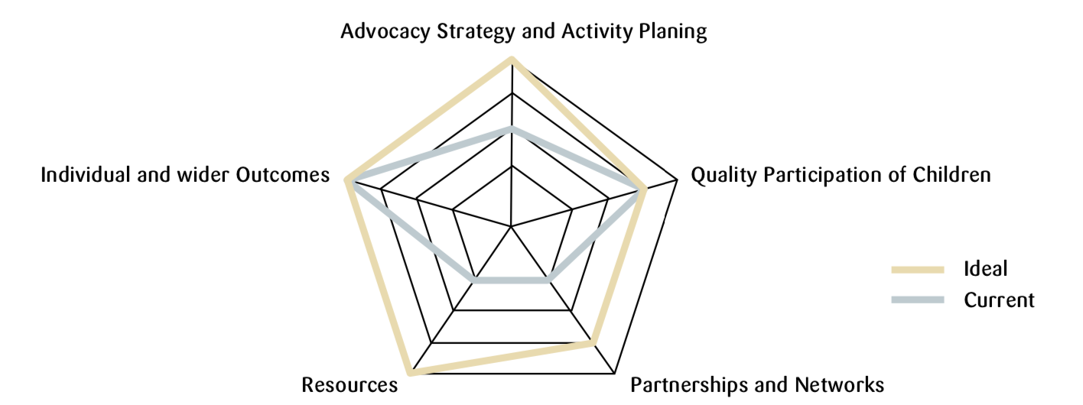
The Spider Tool

Slide 18

Quality participation of children in advocacy actions and initiatives
1 | 2 | 3 | 4
Girls and boys are barely engaged in planning and/ or implementation of advocacy. The staff does not know anything about the nine basic requirements for an ethical and effective participation of children; communication with children groups and associations is limited to the few times the agency requires their attendance to conferences, events, or campaigns. | Children are somehow in- volved in both advocacy planning and implementation (e.g. through consultations to decide about an activity). Some of the staff in direct contact with children is aware of the nine basic requirements for an ethical and effective participation of children; they keep children informed about the advocacy agenda and activities; child-friendly tools are sometimes used to engage children in the advocacy actions; occasionally children are given feedback about their participation. | Children are regularly in- volved in both advocacy planning and implementation; they work collaboratively with adults for specific advocacy actions. All the staff in direct contact with children is aware of the nine basic requirements for an ethical and effective participation of child- ren; efforts are made to ensure getting both parents and children’s consent to participate; to involve children with disabilities, children from minority ethnic groups, migrant children, refugee and stateless children. Occasionally children are given feedback about their participation. | A system is in place to ensure permanent participation of children in advocacy planning and implementation (e.g. children’s groups and associations have delegates for advocacy planning sessions). All the staff is familiar with the nine basic requirements for an ethical and effective participation of children; children’s groups and associations are supported by trained staff on child safeguarding and participation; the nine basic requirements are assured throughout planning and implementation of advocacy actions; the activities engage children with disabilities, children from minority ethnic groups, migrant children, refugee and stateless children. Children are in regular contact with the advocacy coordinator for input and feedback.

Slide 19
Conclusion
Voice
Champion
Platform

Slide 20

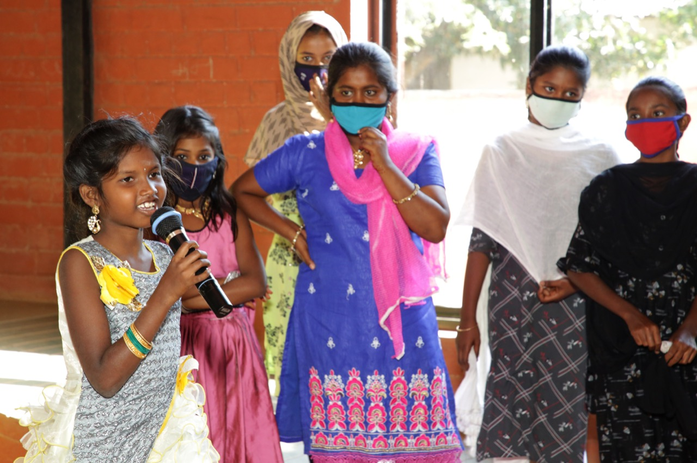
Thank you!
‘The greatest lessons in life, if we would but stoop and humble ourselves, we would learn not from the grown-up learned men, but from the so-called ignorant children.’ – Mahatma Gandhi

